Slide 1
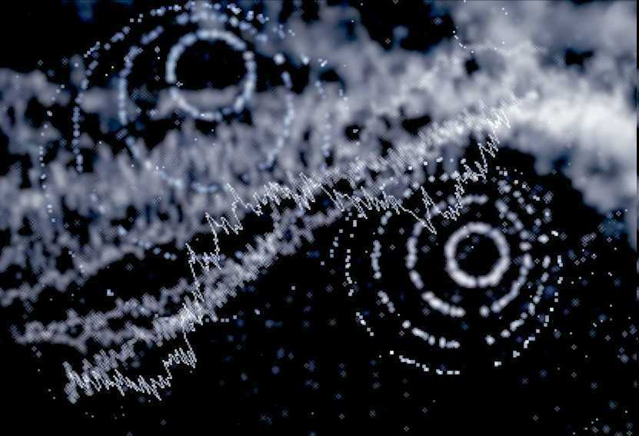
Atoms and Periodic Table Unit
Part I

Slide 2

-Nice neat notes that are legible and use indents when appropriate. -Example of indent. -Skip a line between topics
-Make visuals clear and well drawn. Please label.
Proton
Electron
Neutron

Slide 3
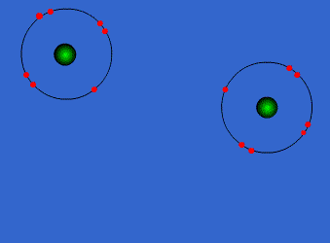
The Atoms and Periodic Table Unit
Copyright © 2010 Ryan P. Murphy

Slide 4
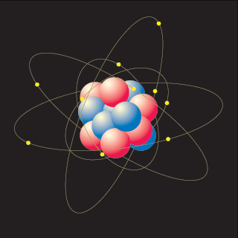
How small is an atom?

Slide 5
Activity! Bringing things down to size.
This is the product of Ryan Murphy Copyright 2010 www.sciencepowerpoint.com
Copyright © 2010 Ryan P. Murphy

Slide 6
Activity! Bringing things down to size.
  Take one sheet of paper 8 by 11.
This is the product of Ryan Murphy Copyright 2010 www.sciencepowerpoint.com
Copyright © 2010 Ryan P. Murphy

Slide 7
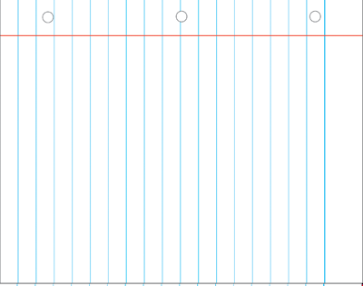
Activity! Bringing things down to size.
  Take one sheet of paper 8 by 11.
This is the product of Ryan Murphy Copyright 2010 www.sciencepowerpoint.com
Copyright © 2010 Ryan P. Murphy

Slide 8
Activity! Bringing things down to size.
  Take one sheet of paper 8 by 11.
  Cut it in half as precisely as possible.
This is the product of Ryan Murphy Copyright 2010 www.sciencepowerpoint.com
Copyright © 2010 Ryan P. Murphy

Slide 9
Activity! Bringing things down to size.
  Take one sheet of paper 8 by 11.
  Cut it in half as precisely as possible.
This is the product of Ryan Murphy Copyright 2010 www.sciencepowerpoint.com
Copyright © 2010 Ryan P. Murphy

Slide 10
Activity! Bringing things down to size.
  Take one sheet of paper 8 by 11.
  Cut it in half as precisely as possible.
  Cut in half again and again. Keep track.
1
This is the product of Ryan Murphy Copyright 2010 www.sciencepowerpoint.com
Copyright © 2010 Ryan P. Murphy

Slide 11
2
This is the product of Ryan Murphy Copyright 2010 www.sciencepowerpoint.com
Copyright © 2010 Ryan P. Murphy

Slide 12
2
This is the product of Ryan Murphy Copyright 2010 www.sciencepowerpoint.com
Line up scraps from large to small.
Copyright © 2010 Ryan P. Murphy

Slide 13
3
This is the product of Ryan Murphy Copyright 2010 www.sciencepowerpoint.com
Copyright © 2010 Ryan P. Murphy

Slide 14
4
This is the product of Ryan Murphy Copyright 2010 www.sciencepowerpoint.com
Copyright © 2010 Ryan P. Murphy

Slide 15
5
This is the product of Ryan Murphy Copyright 2010 www.sciencepowerpoint.com
Copyright © 2010 Ryan P. Murphy

Slide 16
6
This is the product of Ryan Murphy Copyright 2010 www.sciencepowerpoint.com
Copyright © 2010 Ryan P. Murphy

Slide 17
7
This is the product of Ryan Murphy Copyright 2010 www.sciencepowerpoint.com
Copyright © 2010 Ryan P. Murphy

Slide 18
8
This is the product of Ryan Murphy Copyright 2010 www.sciencepowerpoint.com
Copyright © 2010 Ryan P. Murphy

Slide 19
9
This is the product of Ryan Murphy Copyright 2010 www.sciencepowerpoint.com
Copyright © 2010 Ryan P. Murphy

Slide 20
10
This is the product of Ryan Murphy Copyright 2010 www.sciencepowerpoint.com
Copyright © 2010 Ryan P. Murphy

Slide 21
11
This is the product of Ryan Murphy Copyright 2010 www.sciencepowerpoint.com
Copyright © 2010 Ryan P. Murphy

Slide 22
12
This is the product of Ryan Murphy Copyright 2010 www.sciencepowerpoint.com
Copyright © 2010 Ryan P. Murphy

Slide 23
13
This is the product of Ryan Murphy Copyright 2010 www.sciencepowerpoint.com
Copyright © 2010 Ryan P. Murphy

Slide 24
14
This is the product of Ryan Murphy Copyright 2010 www.sciencepowerpoint.com
Copyright © 2010 Ryan P. Murphy

Slide 25
15
This is the product of Ryan Murphy Copyright 2010 www.sciencepowerpoint.com
Copyright © 2010 Ryan P. Murphy

Slide 26
16
This is the product of Ryan Murphy Copyright 2010 www.sciencepowerpoint.com
Copyright © 2010 Ryan P. Murphy

Slide 27
17
This is the product of Ryan Murphy Copyright 2010 www.sciencepowerpoint.com
Copyright © 2010 Ryan P. Murphy

Slide 28
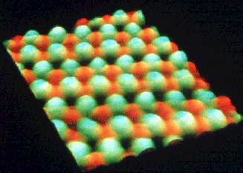
84

Slide 29
85

Slide 30
86
Copyright © 2010 Ryan P. Murphy

Slide 31
87

Slide 32
88

Slide 33
89
Copyright © 2010 Ryan P. Murphy

Slide 34
90

Slide 35
Answer: If you were to cut the paper in half about 90 times, you would be around the size of the atom.
90

Slide 36
Answer: If you were to cut the paper in half about 90 times, you would be around the size of the atom. The atom is incredibly small.
90
Copyright © 2010 Ryan P. Murphy

Slide 37
Answer: If you were to cut the paper in half about 90 times, you would be around the size of the atom.
90
Please clean
up all of the atoms.
Copyright © 2010 Ryan P. Murphy

Slide 38

About a million atoms stacked on top of each other = the thickness of a sheet of paper.
Copyright © 2010 Ryan P. Murphy

Slide 39
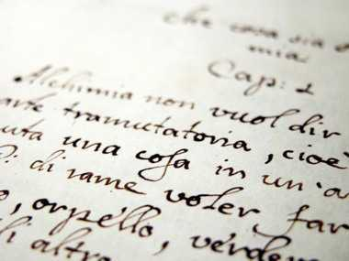
About 5 million atoms make up a period at the end of a sentence.
Copyright © 2010 Ryan P. Murphy

Slide 40
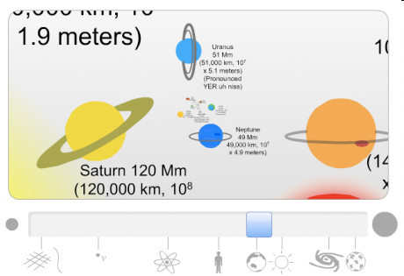
Link! Size Scale of the Universe (Flash)
From Sub-Atomic to the Universe.
  http://scaleofuniverse.com

Slide 41
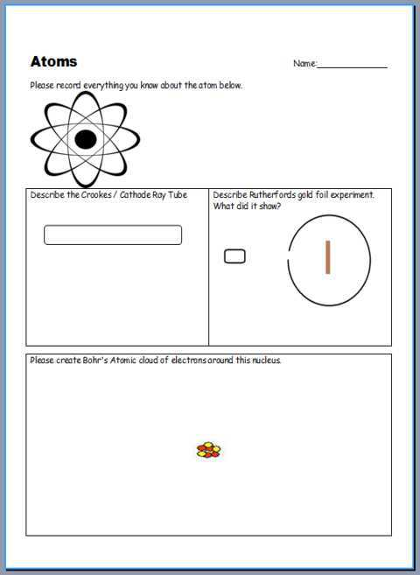
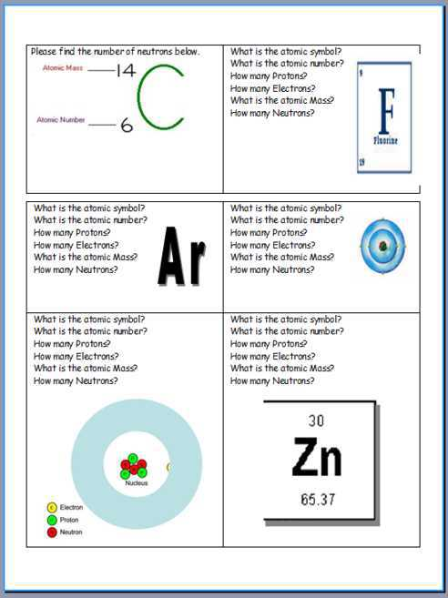
Atoms worksheet available.

Slide 42
Atoms worksheet available.

Slide 43
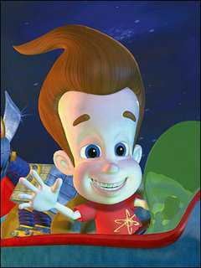
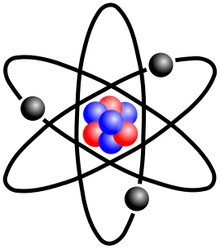
Journal Question?
  Please use the round Petri-dish to create a circle.
  Inside the circle, write everything you know about the atom.
Copyright © 2010 Ryan P. Murphy

Slide 44
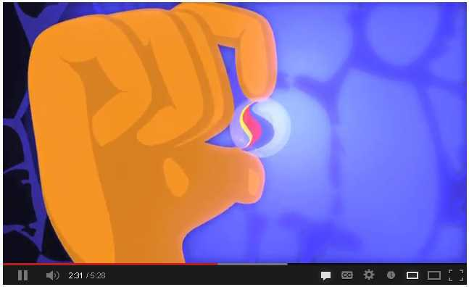
Video Link! The size of atoms
  http://www.youtube.com/watch?v=yQP4UJhNn0I
Copyright © 2010 Ryan P. Murphy

Slide 45
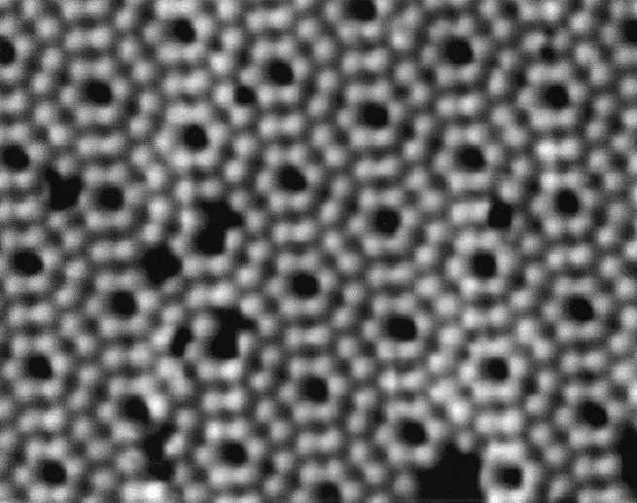
Video! A look at the atoms in steel.
Look closely to get a good look atom ☺.
  http://www.youtube.com/watch?v=dNvdrpEmS48
Copyright © 2010 Ryan P. Murphy

Slide 46
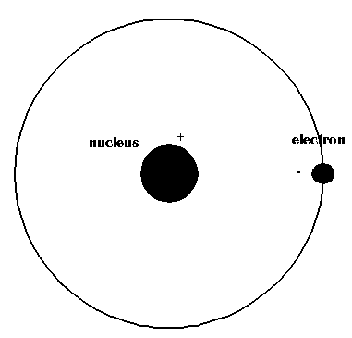
An atom has charged particles, this means it has a (+) and a (-) charge.
Copyright © 2010 Ryan P. Murphy

Slide 47
An atom has charged particles, this means it has a (+) and a (-) charge.
  Atoms and some of the particles they are made of carry a charge.
Copyright © 2010 Ryan P. Murphy

Slide 48
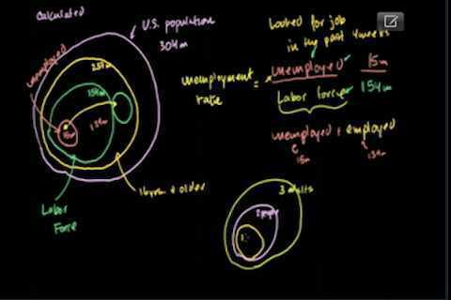
(Optional) Recommended Link! Khan Academy Introduces the Atom.
21 minutes
http://www.khanacademy.org/video/introduction-to-the-atom?playlist=Chemistry

Slide 49
Atoms worksheet available.

Slide 50
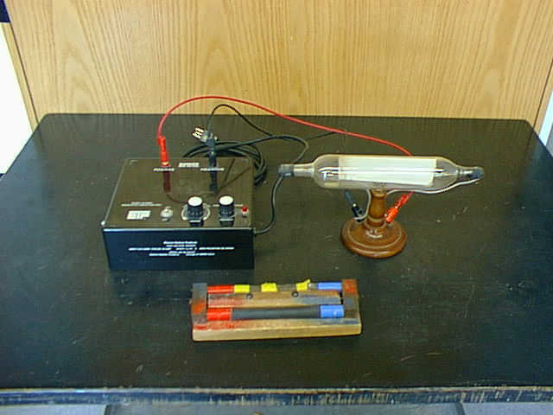
Early experiments realized that that atoms were charged particles. One of those experiments is a Crookes tube.
Copyright © 2010 Ryan P. Murphy

Slide 51

Early experiments realized that that atoms were charged particles. One of those experiments is a Crookes tube.
“Hoot” “Hoot” I can’t wait to see how this Crookes tube thing works.”
Copyright © 2010 Ryan P. Murphy

Slide 52
Early experiments realized that that atoms were charged particles. One of those experiments is a Crookes tube.
Copyright © 2010 Ryan P. Murphy

Slide 53
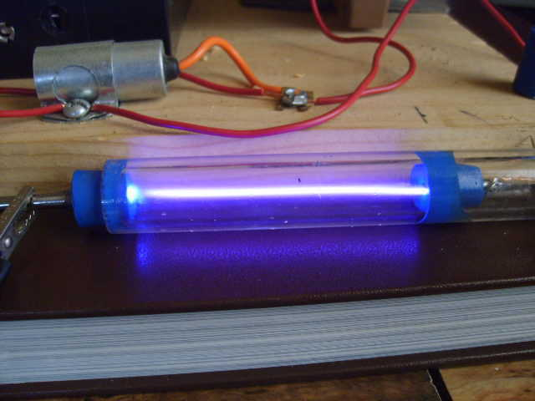
Video! Cathode Ray tube.
  Record a picture of it in your journal and how it worked to help show that atoms carry a charge.
  http://www.youtube.com/watch?v=XU8nMKkzbT8
+
-
Copyright © 2010 Ryan P. Murphy

Slide 54
+
-
-
Copyright © 2010 Ryan P. Murphy

Slide 55
+
-
-
+
Copyright © 2010 Ryan P. Murphy

Slide 56
Like charges (-) (-) repel. The Electron is negative.
+
-
-
+
Copyright © 2010 Ryan P. Murphy

Slide 57
+
-
-
+
Copyright © 2010 Ryan P. Murphy

Slide 58
+
-
+
-
Copyright © 2010 Ryan P. Murphy

Slide 59
+
-
+
-
Copyright © 2010 Ryan P. Murphy

Slide 60
Opposite charges attract (+) (-). The electrons are negative.
+
-
+
-
Copyright © 2010 Ryan P. Murphy

Slide 61
What did this study find?
It helped lead to J.J. Thompson to realizing that this ray is negatively charged. (electron)
+
-
+
-
Copyright © 2010 Ryan P. Murphy

Slide 62
What did this study find?
  It helped lead J.J. Thompson to realizing that this ray is negatively charged. (electron)
+
-
+
-
Copyright © 2010 Ryan P. Murphy

Slide 63
What did this study find?
  It helped lead J.J. Thompson to realizing that this ray is negatively charged. (electron)
+
-
Learn more: http://explorable.com/cathode-ray-experiment.html
+
-
Copyright © 2010 Ryan P. Murphy

Slide 64
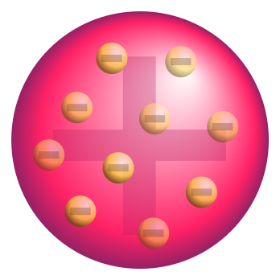
Copyright © 2010 Ryan P. Murphy

Slide 65
Copyright © 2010 Ryan P. Murphy

Slide 66
Knowing that an atom had a charge was just the first step. Scientists still didn’t know the structure of the atom.
Copyright © 2010 Ryan P. Murphy

Slide 67
Knowing that an atom had a charge was just the first step. Scientists still didn’t know the structure of the atom.
  J.J. Thompsons early plum pudding model of an atom.
Copyright © 2010 Ryan P. Murphy

Slide 68
Knowing that an atom had a charge was just the first step. Scientists still didn’t know the structure of the atom.
  J.J. Thompsons early plum pudding model of an atom. (This was incorrect)
Copyright © 2010 Ryan P. Murphy

Slide 69
Atoms worksheet available.

Slide 70
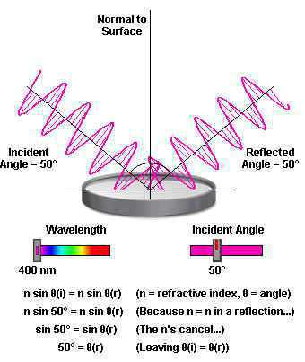
Ernest Rutherford’s experiment used particles and reflection to determine the structure of the atom.
  What is the mystery shape in the next slide, using your knowledge of reflection?
Copyright © 2010 Ryan P. Murphy

Slide 71
Ernest Rutherford’s experiment used particles and reflection to determine the structure of the atom.
  What is the mystery shape in the next slide. Use your knowledge of reflection?
Copyright © 2010 Ryan P. Murphy

Slide 72
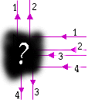
Try and guess the mystery shape below based on how objects would reflect off it.
Copyright © 2010 Ryan P. Murphy

Slide 73
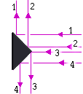
Answer!
Copyright © 2010 Ryan P. Murphy

Slide 74
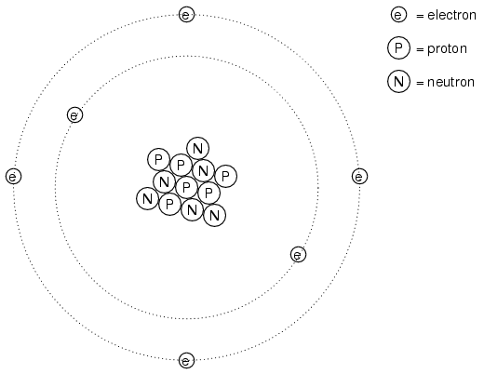
An Atom is the smallest part of an element which can take part in a chemical reaction.
Copyright © 2010 Ryan P. Murphy

Slide 75
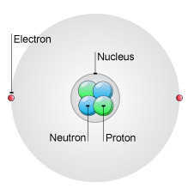
The atom consists of three fundamental particles
  -
  -
  -
Copyright © 2010 Ryan P. Murphy

Slide 76
Proton + (positive charge)
Copyright © 2010 Ryan P. Murphy

Slide 77
Proton + (positive charge)
Copyright © 2010 Ryan P. Murphy

Slide 78
Proton + (positive charge)
+
Copyright © 2010 Ryan P. Murphy

Slide 79
Proton + (positive charge)
Copyright © 2010 Ryan P. Murphy

Slide 80
Proton + (positive charge)
+
+
Copyright © 2010 Ryan P. Murphy

Slide 81
Proton + (positive charge)
This atom will
always have 2 Protons
+
+
Copyright © 2010 Ryan P. Murphy

Slide 82
Neutron 0 (neutral charge / no charge)
Copyright © 2010 Ryan P. Murphy

Slide 83
Neutron 0 (neutral charge / no charge)
Copyright © 2010 Ryan P. Murphy

Slide 84
Neutron 0 (neutral charge / no charge).
Copyright © 2010 Ryan P. Murphy

Slide 85
Neutron: A particle that appears in the nucleus of all atoms except hydrogen.
Copyright © 2010 Ryan P. Murphy

Slide 86
Neutron: A particle that appears in the nucleus of all atoms except hydrogen.
  Neutrons have no electrical charge and just a bit more mass than a proton.
Copyright © 2010 Ryan P. Murphy

Slide 87
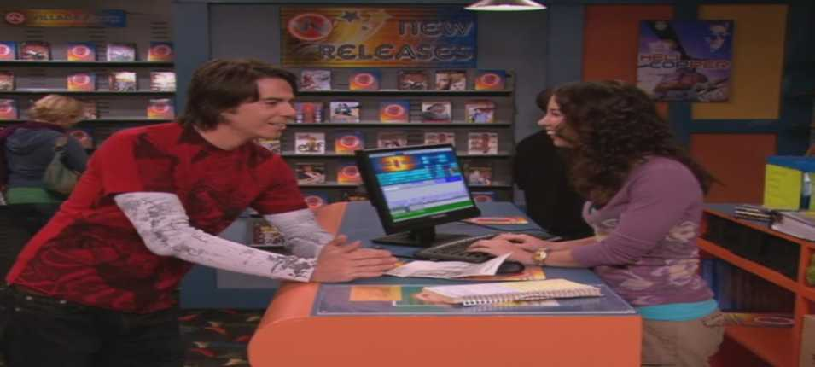
Neutron: A particle that appears in the nucleus of all atoms except hydrogen.
  Neutrons have no electrical charge and just a bit more mass than a proton.
Copyright © 2010 Ryan P. Murphy

Slide 88
Neutron: A particle that appears in the nucleus of all atoms except hydrogen.
  Neutrons have no electrical charge and just a bit more mass than a proton.
  A neutron walks into a video store.
Copyright © 2010 Ryan P. Murphy

Slide 89
Neutron: A particle that appears in the nucleus of all atoms except hydrogen.
  Neutrons have no electrical charge and just a bit more mass than a proton.
  He asks the clerk “How much are the movies?”
Copyright © 2010 Ryan P. Murphy

Slide 90
Neutron: A particle that appears in the nucleus of all atoms except hydrogen.
  Neutrons have no electrical charge and just a bit more mass than a proton.
  He asks the clerk “How much are the movies?”
“For you…”
“No Charge.”
Copyright © 2010 Ryan P. Murphy

Slide 91
Neutron: A particle that appears in the nucleus of all atoms except hydrogen.
  Neutrons have no electrical charge and just a bit more mass than a proton.
  He asks the clerk “How much are the movies?”
“For you…”
“No Charge.”
Copyright © 2010 Ryan P. Murphy

Slide 92
Neutron: A particle that appears in the nucleus of all atoms except hydrogen.
  Neutrons have no electrical charge and just a bit more mass than a proton.
  He asks the clerk “How much are the movies?”
Copyright © 2010 Ryan P. Murphy

Slide 93
Electron – (negative charge)
Copyright © 2010 Ryan P. Murphy

Slide 94
+
Copyright © 2010 Ryan P. Murphy

Slide 95
+
Copyright © 2010 Ryan P. Murphy

Slide 96
+
Copyright © 2010 Ryan P. Murphy

Slide 97
Nucleus: The positively charged center of the atom.
Copyright © 2010 Ryan P. Murphy

Slide 98
Nucleus: The positively charged center of the atom.
  The nucleus has an incredibly high density.
Copyright © 2010 Ryan P. Murphy

Slide 99
Nucleus: The positively charged center of the atom.
  The nucleus has an incredibly high density.
  Equal to a million million million kg m⁻³ or a thousand million million tonnes m⁻³
Copyright © 2010 Ryan P. Murphy

Slide 100
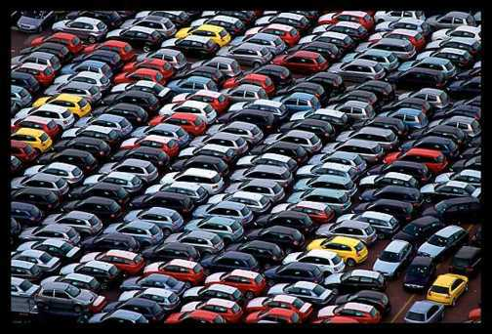


Nucleus: The positively charged center of the atom.
  The nucleus has an incredibly high density.
  Or 6 billion or so cars stuffed into a small cardboard box.
Copyright © 2010 Ryan P. Murphy

Slide 101
Nucleus: The positively charged center of the atom.
  The nucleus has an incredibly high density.
Copyright © 2010 Ryan P. Murphy

Slide 102

Quiz Wiz! 1-10 Name that part of the Atom.
  Proton, Neutron, Electron, Nucleus
Copyright © 2010 Ryan P. Murphy

Slide 103
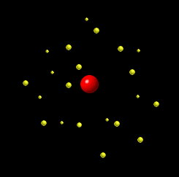
1

Slide 104
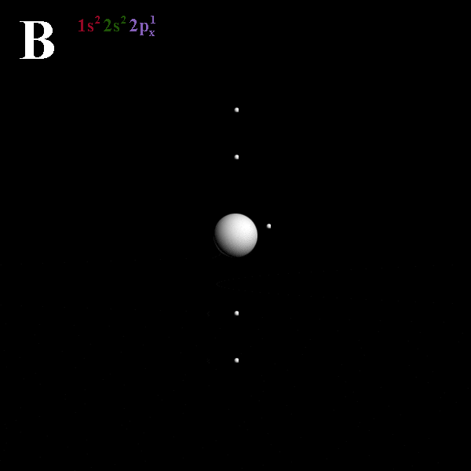
2

Slide 105
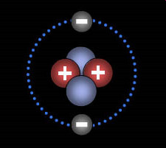
3

Slide 106

Answers! 1-10 Name that part of the Atom.
Proton, Neutron, Electron, Nucleus
Copyright © 2010 Ryan P. Murphy

Slide 107
1

Slide 108
1
Nucleus

Slide 109
1
Nucleus
Could be the proton in Hydrogen and the electron is flying around.

Slide 110
2

Slide 111
2
Electron

Slide 112
3

Slide 113
Neutron
3

Slide 114
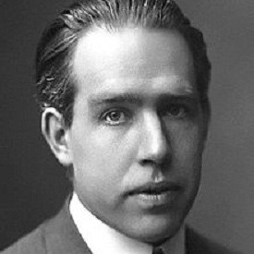
Neils Bohr Model (1913):
Copyright © 2010 Ryan P. Murphy

Slide 115
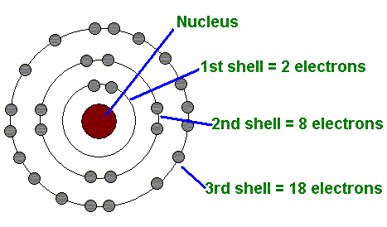
Neils Bohr Model (1913): Depicts the atom as a small, positively charged nucleus surrounded by electrons that travel in circular orbits around the nucleus
  .
Copyright © 2010 Ryan P. Murphy

Slide 116
Neils Bohr Model (1913): Depicts the atom as a small, positively charged nucleus surrounded by electrons that travel in circular orbits around the nucleus
  .
Older Model
Copyright © 2010 Ryan P. Murphy

Slide 117
Neils Bohr Model (1913): Depicts the atom as a small, positively charged nucleus surrounded by electrons that travel in circular orbits around the nucleus
  .
Older Model
Because of its simplicity, the Bohr model is still commonly taught to introduce students to quantum mechanics.
Copyright © 2010 Ryan P. Murphy

Slide 118
Neils Bohr Model (1913): Depicts the atom as a small, positively charged nucleus surrounded by electrons that travel in circular orbits around the nucleus
  .
We will touch upon this later in the unit.
Older Model
Because of its simplicity, the Bohr model is still commonly taught to introduce students to quantum mechanics.
Copyright © 2010 Ryan P. Murphy

Slide 119
Atoms worksheet available.

Slide 120
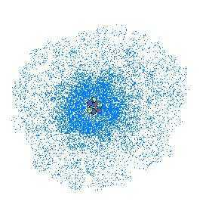
Activity – Creating an accurate model of an atom. Atomic Cloud model.
  Please make a nucleus 3 Protons (+) and 4 Neutrons (O)
Copyright © 2010 Ryan P. Murphy

Slide 121
Activity – Creating an accurate model of an atom. Atomic Cloud model.
  Please make a nucleus 3 Protons (+) and 4 Neutrons (O)
  Then make 500 hundred dots that represent the 3 electrons moving around at the speed of light.
Copyright © 2010 Ryan P. Murphy

Slide 122
Activity – Creating an accurate model of an atom. Atomic Cloud model.
  Please make a nucleus 3 Protons (+) and 4 Neutrons (O)
  Then make 500 hundred dots that represent the 3 electrons moving around at the speed of light.
Circle three electrons
Copyright © 2010 Ryan P. Murphy

Slide 123
Activity – Creating an accurate model of an atom. Atomic Cloud model.
  Please make a nucleus 3 Protons (+) and 4 Neutrons (O)
  Then make 500 hundred dots that represent the 3 electrons moving around at the speed of light.
Circle three electrons
Electron Cloud of Lithium
Copyright © 2010 Ryan P. Murphy

Slide 124
Activity – Creating an accurate model of an atom. Atomic Cloud model.
  Please make a nucleus 3 Protons (+) and 4 Neutrons (O)
  Then make 500 hundred dots that represent the 3 electrons moving around at the speed of light.
Circle three electrons
The Electron is everywhere
and nowhere
Electron Cloud of Lithium
Copyright © 2010 Ryan P. Murphy

Slide 125
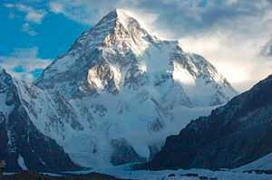

Slide 126
Take away the
empty space in
these atoms

Slide 133
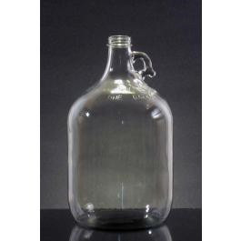
The mountain could
fit in a jug.

Slide 134
The mountain could
fit in a jug.
Everything is made
chiefly of…

Slide 135
The mountain could
fit in a jug.
Everything is made
chiefly of…
NOTHING

Slide 136
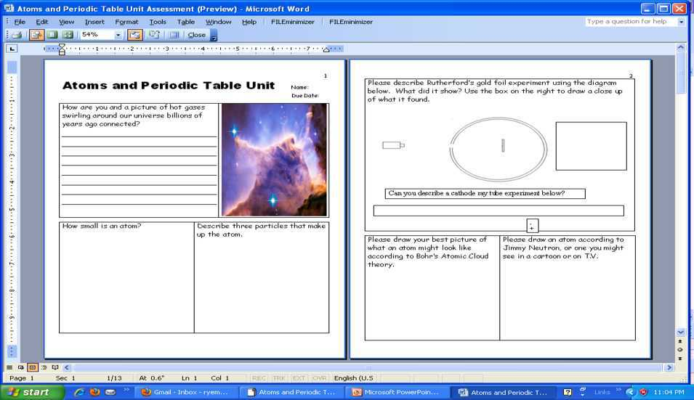
You should have completed page 2 of the bundled homework package.

Slide 137
You should have completed page 2 of the bundled homework package.

Slide 138
You should have completed page 2 of the bundled homework package.

Slide 139
You should have completed page 2 of the bundled homework package.

Slide 140
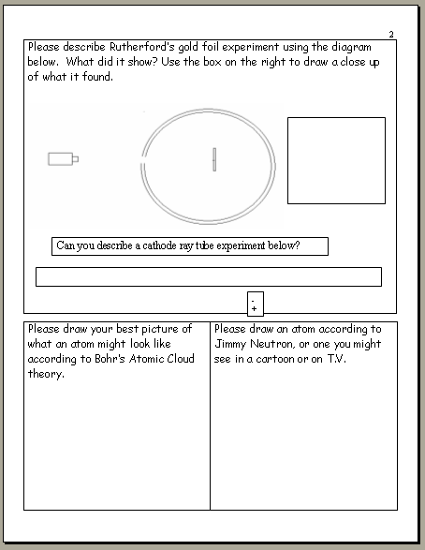

Slide 146
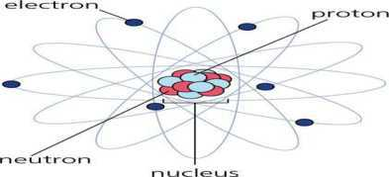

Slide 147
Atoms always have the same number of protons and electrons, this is called the atomic number.
Copyright © 2010 Ryan P. Murphy

Slide 148
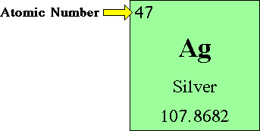
Atoms always have the same number of protons and electrons, this is called the atomic number.
Copyright © 2010 Ryan P. Murphy

Slide 149
Atoms always have the same number of protons and electrons, this is called the atomic number.
Silver will
Always have
47 Protons
in its nucleus
Copyright © 2010 Ryan P. Murphy

Slide 150
Atoms always have the same number of protons and electrons, this is called the atomic number.
Silver will
Always have
47 Protons
in its nucleus
Copyright © 2010 Ryan P. Murphy

Slide 151
Atoms always have the same number of protons and electrons, this is called the atomic number.
Silver will
Always have
47 Protons
in its nucleus
Copyright © 2010 Ryan P. Murphy

Slide 152
Atoms always have the same number of protons and electrons, this is called the atomic number.
All atoms must be electrically balanced.
Silver will
Always have
47 Protons
in its nucleus
Copyright © 2010 Ryan P. Murphy

Slide 153
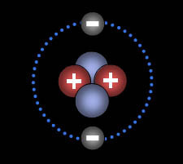
What atom is this How can you tell?
Copyright © 2010 Ryan P. Murphy

Slide 154
Answer! (2 Protons) Atomic #2
Copyright © 2010 Ryan P. Murphy

Slide 155
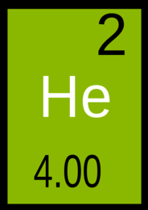
Answer! (2 Protons) Atomic #2 (Helium)
Copyright © 2010 Ryan P. Murphy

Slide 156
Answer! (2 Protons) Atomic #2 (Helium)
Copyright © 2010 Ryan P. Murphy

Slide 157
Answer! (2 Protons) Atomic #2 (Helium)
Atomic Mass
Copyright © 2010 Ryan P. Murphy

Slide 158
Answer! (2 Protons) Atomic #2 (Helium)
Almost no
mass
Atomic Mass
Copyright © 2010 Ryan P. Murphy

Slide 159
Atomic Number
Atomic Symbol
Name
Atomic Mass
Copyright © 2010 Ryan P. Murphy

Slide 160
Atomic Number
Atomic Symbol
Name
Atomic Mass
Copyright © 2010 Ryan P. Murphy

Slide 161
Atomic Number
Atomic Symbol
Name
Atomic Mass
Copyright © 2010 Ryan P. Murphy
Copyright © 2010 Ryan P. Murphy

Slide 162
Slideshow will skip
ahead for this
preview
Atoms and Periodic Table of the Elements Unit on TpT

Slide 163
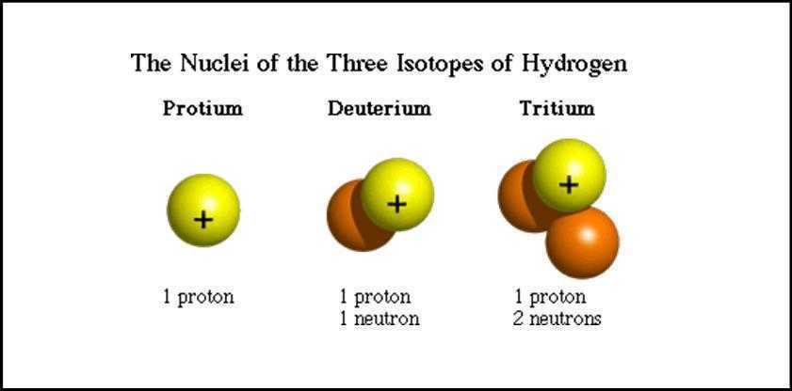
Isotope: Atom with the same number of protons and electrons but different numbers of neutrons.
Copyright © 2010 Ryan P. Murphy

Slide 164
Isotope: Atom with the same number of protons and electrons but different numbers of neutrons.
Copyright © 2010 Ryan P. Murphy

Slide 165
Isotope: Atom with the same number of protons and electrons but different numbers of neutrons.
Copyright © 2010 Ryan P. Murphy

Slide 166
Isotope: Atom with the same number of protons and electrons but different numbers of neutrons.
Copyright © 2010 Ryan P. Murphy

Slide 167
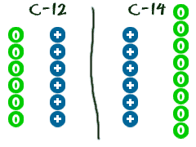
Two Carbon Isotopes, C-12, and C-14
Copyright © 2010 Ryan P. Murphy

Slide 168
Two Carbon Isotopes, C-12, and C-14
Copyright © 2010 Ryan P. Murphy

Slide 169
Two Carbon Isotopes, C-12, and C-14
Copyright © 2010 Ryan P. Murphy

Slide 170
Two Carbon Isotopes, C-12, and C-14
Copyright © 2010 Ryan P. Murphy

Slide 171
Two Carbon Isotopes, C-12, and C-14
Two extra neutrons
Copyright © 2010 Ryan P. Murphy

Slide 172
Two Carbon Isotopes, C-12, and C-14
Two extra neutrons
An isotope is just a
heavier form of the
same element.
Copyright © 2010 Ryan P. Murphy

Slide 173
Two Carbon Isotopes, C-12, and C-14
Carbon will always have 6 protons in its nucleus
Two extra neutrons
An isotope is just a
heavier form of the
same element.
Copyright © 2010 Ryan P. Murphy

Slide 174
Two Carbon Isotopes, C-12, and C-14
Carbon will always have 6 protons in its nucleus
Two extra neutrons
An isotope is just a
heavier form of the
same element.
Copyright © 2010 Ryan P. Murphy

Slide 175
Two Carbon Isotopes, C-12, and C-14
Carbon will always have 6 protons in its nucleus
Two extra neutrons
Copyright © 2010 Ryan P. Murphy

Slide 176
Atoms worksheet available.

Slide 177
Slideshow will skip
ahead for this
preview
Atoms and Periodic Table of the Elements Unit on TpT

Slide 178

What is the atomic symbol?
What is the atomic number?
  How many Protons?
  How many Electrons?
What is the atomic Mass?
  How many Neutrons?
Copyright © 2010 Ryan P. Murphy

Slide 179
What is the atomic symbol? F
What is the atomic number?
  How many Protons?
  How many Electrons?
What is the atomic Mass?
  How many Neutrons?
Copyright © 2010 Ryan P. Murphy

Slide 180
What is the atomic symbol? F
What is the atomic number?
  How many Protons?
  How many Electrons?
What is the atomic Mass?
  How many Neutrons?
Copyright © 2010 Ryan P. Murphy

Slide 181
What is the atomic symbol? F
What is the atomic number? 9
  How many Protons?
  How many Electrons?
What is the atomic Mass?
  How many Neutrons?
Copyright © 2010 Ryan P. Murphy

Slide 182
What is the atomic symbol? F
What is the atomic number? 9
  How many Protons?
  How many Electrons?
What is the atomic Mass?
  How many Neutrons?
Copyright © 2010 Ryan P. Murphy

Slide 183
What is the atomic symbol? F
What is the atomic number? 9
  How many Protons? 9
  How many Electrons?
What is the atomic Mass?
  How many Neutrons?
Copyright © 2010 Ryan P. Murphy

Slide 184
What is the atomic symbol? F
What is the atomic number? 9
  How many Protons? 9
  How many Electrons?
What is the atomic Mass?
  How many Neutrons?
Copyright © 2010 Ryan P. Murphy

Slide 185
What is the atomic symbol? F
What is the atomic number? 9
  How many Protons? 9
  How many Electrons? 9
What is the atomic Mass?
  How many Neutrons?
Copyright © 2010 Ryan P. Murphy

Slide 186
What is the atomic symbol? F
What is the atomic number? 9
  How many Protons? 9
  How many Electrons? 9
What is the atomic Mass?
  How many Neutrons?
Copyright © 2010 Ryan P. Murphy

Slide 187
What is the atomic symbol? F
What is the atomic number? 9
  How many Protons? 9
  How many Electrons? 9
What is the atomic Mass? 19 amu
  How many Neutrons?
Copyright © 2010 Ryan P. Murphy

Slide 188
What is the atomic symbol? F
What is the atomic number? 9
  How many Protons? 9
  How many Electrons? 9
What is the atomic Mass? 19 amu
  How many Neutrons?
Copyright © 2010 Ryan P. Murphy

Slide 189
What is the atomic symbol? F
What is the atomic number? 9
  How many Protons? 9
  How many Electrons? 9
What is the atomic Mass? 19 amu
  How many Neutrons?
  19
Copyright © 2010 Ryan P. Murphy

Slide 190
What is the atomic symbol? F
What is the atomic number? 9
  How many Protons? 9
  How many Electrons? 9
What is the atomic Mass? 19 amu
  How many Neutrons?
  19 -
Copyright © 2010 Ryan P. Murphy

Slide 191
What is the atomic symbol? F
What is the atomic number? 9
  How many Protons? 9
  How many Electrons? 9
What is the atomic Mass? 19 amu
  How many Neutrons?
  19 - 9
Copyright © 2010 Ryan P. Murphy

Slide 192
What is the atomic symbol? F
What is the atomic number? 9
  How many Protons? 9
  How many Electrons? 9
What is the atomic Mass? 19 amu
  How many Neutrons?
  19 - 9 = 10
Copyright © 2010 Ryan P. Murphy

Slide 193
Atoms worksheet available.

Slide 194
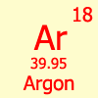
What is the atomic symbol?
What is the atomic number?
  How many Protons?
  How many Electrons?
What is the atomic Mass?
  How many Neutrons?
Copyright © 2010 Ryan P. Murphy

Slide 195
What is the atomic symbol?
What is the atomic number?
  How many Protons?
  How many Electrons?
What is the atomic Mass?
  How many Neutrons?
opyright © 2010 Ryan P. Murphy

Slide 196
What is the atomic symbol? Ar
What is the atomic number?
  How many Protons?
  How many Electrons?
What is the atomic Mass?
  How many Neutrons?

Slide 197
What is the atomic symbol? Ar
What is the atomic number?
  How many Protons?
  How many Electrons?
What is the atomic Mass?
  How many Neutrons?

Slide 198
What is the atomic symbol? Ar
What is the atomic number? 18
  How many Protons?
  How many Electrons?
What is the atomic Mass?
  How many Neutrons?

Slide 199
What is the atomic symbol? Ar
What is the atomic number? 18
  How many Protons?
  How many Electrons?
What is the atomic Mass?
  How many Neutrons?

Slide 200
What is the atomic symbol? Ar
What is the atomic number? 18
  How many Protons? 18
  How many Electrons?
What is the atomic Mass?
  How many Neutrons?

Slide 201
What is the atomic symbol? Ar
What is the atomic number? 18
  How many Protons? 18
  How many Electrons?
What is the atomic Mass?
  How many Neutrons?

Slide 202
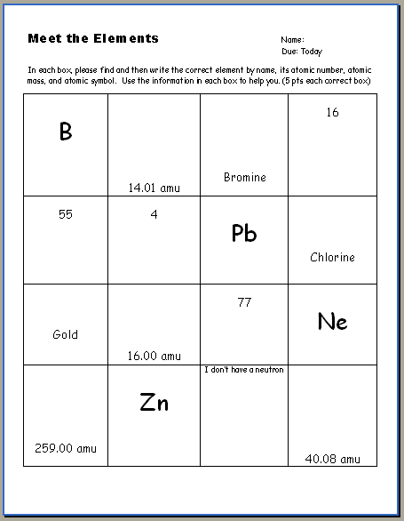

Slide 203
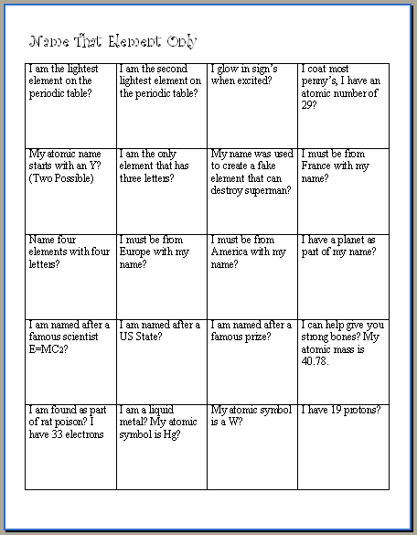

Slide 204
Neonn
Hydrogen
Helium
Krypton, Argon, Xenon, Helium
Copper

Slide 205
Answers

Slide 206
Answers
5
7
35
N
Br
S
Boron
10.81 amu
Nitrogen
Sulfur 32.065
79.90 amu
82
17
Cl
Cs
Be
Cesium 132.91
Beryllium 9.01
Lead 207.20
35.45 amu
79
Au
8
O
10
Ir
Oxygen
196.97 amu
Iridium 192.22
Neon 20.18
102
30
20
No
1
H
Ca
Nobelium
Zinc
Hydrogen
Calcium
65.41
1.01

Slide 207
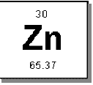
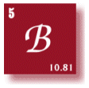
What is the atomic symbol?
What is the atomic number?
  How many Protons?
  How many Electrons?
What is the atomic Mass?
  How many Neutrons?
Copyright © 2010 Ryan P. Murphy

Slide 208
What is the atomic symbol?
What is the atomic number?
  How many Protons?
  How many Electrons?
What is the atomic Mass?
  How many Neutrons?
Copyright © 2010 Ryan P. Murphy

Slide 209
What is the atomic symbol? Zn
What is the atomic number? 30
  How many Protons? 30
  How many Electrons? 30
What is the atomic Mass? 65.37 amu
  How many Neutrons? 35
Copyright © 2010 Ryan P. Murphy

Slide 210
What is the atomic symbol?
What is the atomic number?
  How many Protons?
  How many Electrons?
What is the atomic Mass?
  How many Neutrons?
Copyright © 2010 Ryan P. Murphy

Slide 211
Slideshow will skip
ahead for this
preview
Atoms and Periodic Table of the Elements Unit on TpT

Slide 212
Quiz Wiz! Exploring some of the Periodic Table because we have it out.
  Have your Periodic Table of the Elements handy. Quiz Wiz for fun….
Copyright © 2010 Ryan P. Murphy

Slide 213

This element only has three letters in its name?
1
Copyright © 2010 Ryan P. Murphy
Copyright © 2010 Ryan P. Murphy

Slide 214
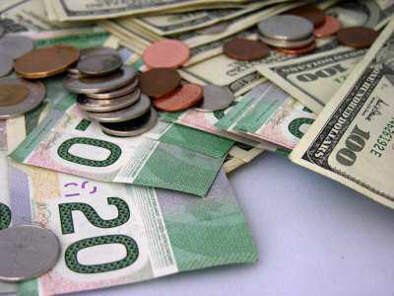
These elements are a form of U.S. currency that we carry around?
2
Copyright © 2010 Ryan P. Murphy

Slide 215
Slideshow will skip
ahead for this
preview
Atoms and Periodic Table of the Elements Unit on TpT

Slide 216
Answers to the Quiz Wiz – Exploring the Periodic Table.
Copyright © 2010 Ryan P. Murphy

Slide 217
This element only has three letters in its name?

Slide 218
This element only has three letters in its name? Tin # 50, Symbol Sn
1
Copyright © 2010 Ryan P. Murphy
Copyright © 2010 Ryan P. Murphy

Slide 219
These elements are a form of U.S. currency that we carry around?
2
Copyright © 2010 Ryan P. Murphy

Slide 220
These elements are a form of U.S. currency that we carry around? Nickel #28, Ni
2
Copyright © 2010 Ryan P. Murphy

Slide 221
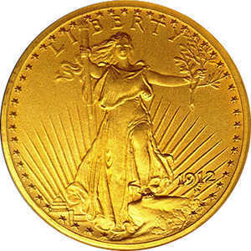
These elements are a form of U.S. currency that we carry around? Also Gold Au #79
2
Au
Copyright © 2010 Ryan P. Murphy

Slide 222
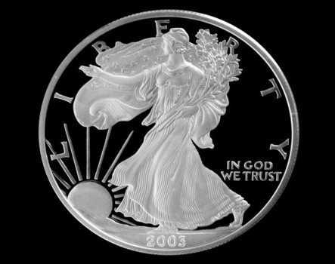
These elements are a form of U.S. currency that we carry around? Also Gold Au #79
and Silver Ag
2
Au
Copyright © 2010 Ryan P. Murphy

Slide 223
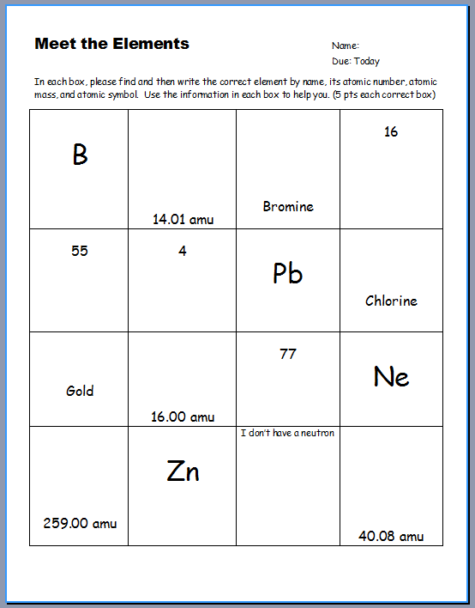

Activity Sheet Available: Meet the Elements. A Nice Review.
Can complete now or
wait until Part V.

Slide 224

Video Link! Nucleus Crash Course.
  (Optional and Advanced)
  http://www.youtube.com/watch?v=FSyAehMdpyI&list=PL8dPuuaLjXtPHzzYuWy6fYEaX9mQQ8oGr

